Slide 1
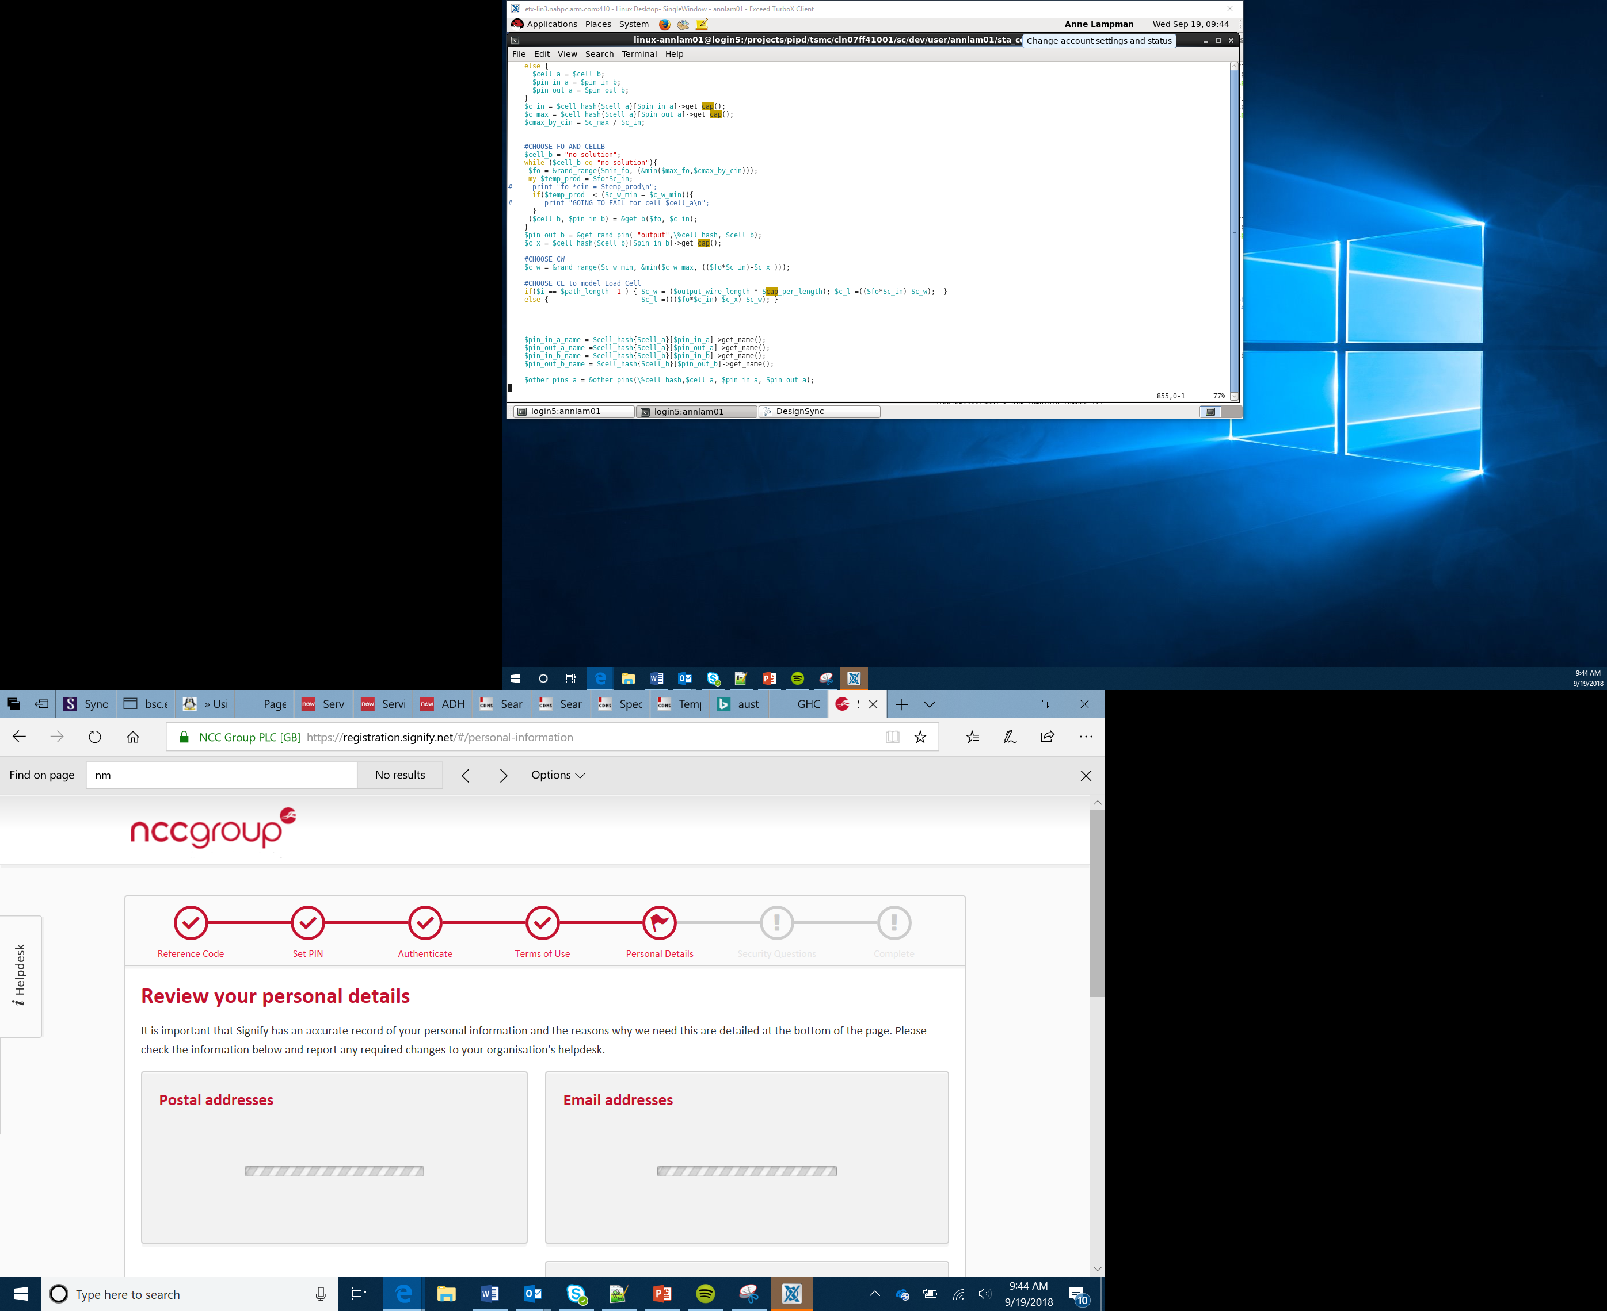

Random Numbers and Encryption
Lesson 9

Slide 2
What the Lesson Will Cover
Know what a random number is
Be able to use the random module to with the micro:bit to code a random number generator
Know the difference between random and true random numbers
Be aware of encryption and its uses
Program an encryption device
Notes:
Introduce the lesson and what it will cover, Learners could discuss or ask question about what the lesson might involve.

Slide 3
Random Number Games
Think of a random number between 1 and 100, can another student guess it?
What is a Random number?
A random number is a number that is not based on a pattern:
for example selecting a random number between 1 and 100 is random.
Selecting only an even number between 2 and 10 has a pattern, although the number selected is still a random choice, it is more ordered.
Notes:
Play random number game, then discuss what a random number is.

Slide 4
Selecting a Random Name
from microbit import *
import random
names = ["Mary", "Damien", "Alia", "Kushal", "Mei Xiu", "Zoltan"]
display.scroll(random.choice(names))
We import the random module, do you remember what modules are?
What is used on line three of the program?
The last line uses the code random.choice()to select a random name
Notes:
Discuss the program and what it does, use the time to recap modules and imports, line 2
Line three is a list, recap the features of lists

Slide 5
Random Numbers
Random numbers may appear random but they are usually based on algorithms or programs which generate them
Selecting a number between 1 and 100 may appear random but it is not a true random number, as we have told the program what to do
Look at the numbers below, can you see a pattern?
1, 1, 2, 3, 5, 8, 13, …
They look random but they are based on a pattern and therefore not random
Notes:
Explain and discuss the differences
The number pattern is the Fibonacci sequence

Slide 6
True Random
A true random number is usually based on a physical element that:
You have no control over
Is expected to be random
Examples of these are:
Background radiation
Pressure
For example, if you use your mouse movement during an unknown time on website this will suitably random
Temperature
Electromagnetic field measurements
Notes:
Explain and discuss the differences

Slide 7
Summary
Random numbers are based on algorithms and programs
True random numbers are based on external physical events or elements that cannot be controlled
Notes:
Explain and discuss the differences

Slide 8
Activity
Complete part one of the Activity Sheet and create you own list and random choice program
This could be a random activity selector
Download to your micro:bit and try it out

Slide 9
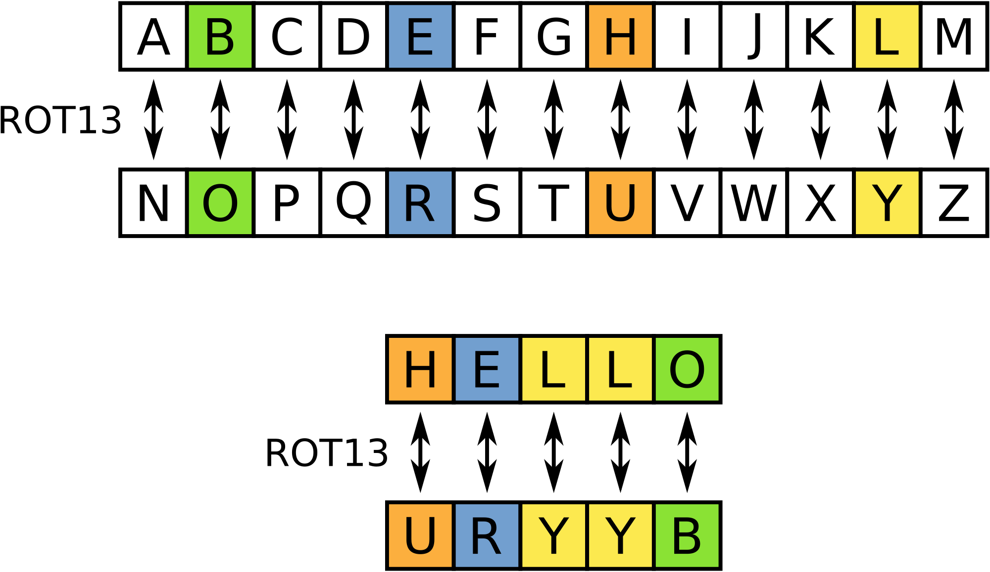
Encryption
Encryption uses letters, number or symbols to code a message so that it does not make sense, unless you have the key to decrypt the message
Encryption has many real world uses, the lottery, online banking, buying products on line, completing an online application form, sending documents
Consider the word URYYB, use the grid to work out what the real word is
Notes:
Explain and talk through what encryption is and its uses.
Use the grid, the letters at the bottom are converted to the letter at the top, for exam A is N and B is O

Slide 10
Encryption
Encryption doesn’t stop data being stolen but if it is then it cannot be understood by the hacker
Random numbers can be used to create a code which replaces letters
For example the word ‘the’ could be replaced with the number 201. Then all uses of the word the are replaced with 201
Encryption also uses numbers such as large prime numbers, these are used in financial transactions on the internet shopping sites and online banking
Notes:
Explain and talk through what encryption is and its uses.

Slide 11
Activity 2: Creating an Encrypted Message
In this activity use the micro:bit to create a simple encryption machine
Use the micro:bit to encrypt your message
Share your message with another student
Can they decrypt it?
Assign the encryption program to the buttons on the micro:bit
Notes:
Students complete Activity 2, teacher to support where required.

